Slide 1
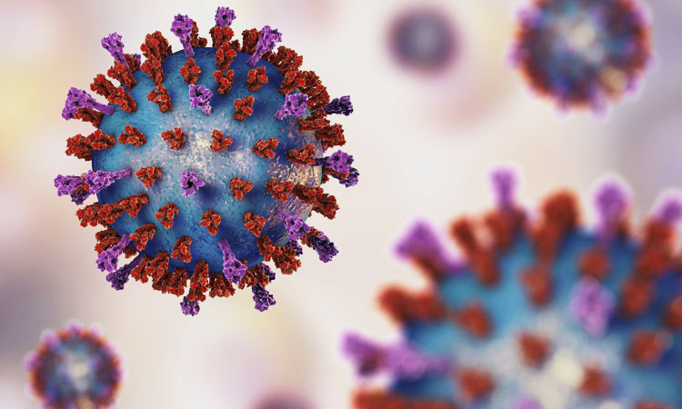
A Lightweight Deep Learning Model for Classifying Different Types of Pneumonia
Project Guide: Ms. Princy N K
Team Members:
Jincy P Janardhanan
Alka Bhagavaldas K
Aleena Sunny
Ameena Shirin
Fathima

Slide 2
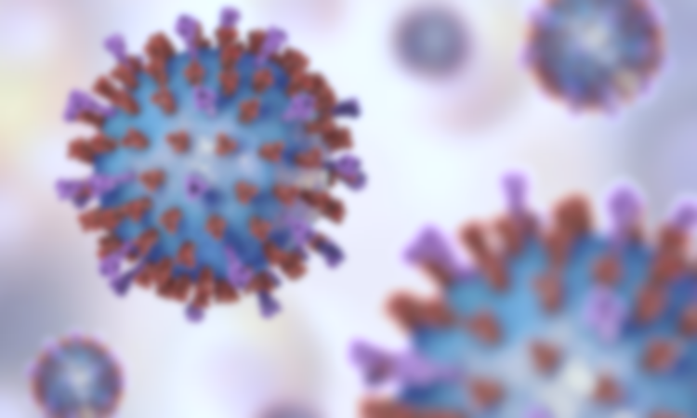
INTRODUCTION
Developing nations are much affected by the risk of pneumonia.
Lack of medical resources and personnel aggravates this risk.
Accurate and fast diagnosis tests are required to prevent disease spread.
Early detection and treatment is necessary to reduce the mortality rate.
Chest scan X-ray images are used for pneumonia diagnosis.
Convolutional Neural Networks (CNNs) help in extracting features of an image.
Spatial Pyramid Pooling (SPP) enhances the diagnostic capability of CNNs.
A lightweight model based on CNNs with a modified SPP is proposed for fast diagnosis of chest X-ray images to detect different types of pneumonia.
The model can help doctors diagnose and predict disease risk accurately and quickly.

Slide 3
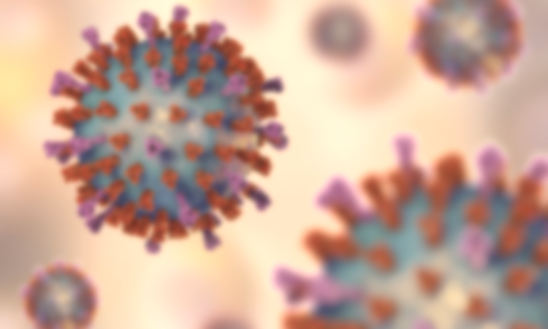
Problem Statement
Pneumonia is highly contagious and has high mortality rates.
Early detection and treatment is required.
Lack of accurate and fast diagnosis tools for pneumonia.
Diagnosis is costly.
Visual examination chest X-rays are time consuming and less accurate.
Potential virus carriers should quarantined as early as possible.
Need of diagnostic software that can be deployed on all common platforms.

Slide 4
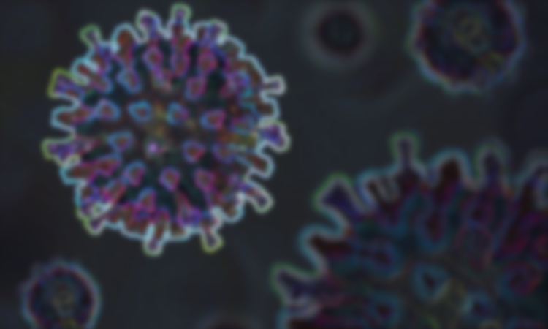
Motivation
Human lives matter the most.
Pneumonia is an epidemic with high mortality rate.
Modern technologies can be put to good use in the health sector.
Recent developments in AI, ML and DL has helped to detect image features with high accuracy and efficiency.
Lightweight models can ensure ease of access to everyone.
Disease diagnosis and treatment should be affordable to all.

Slide 5

Objectives
To identify pneumonia of different types for various severity levels.
Alleviate economic burden of mass diagnosis tests.
Develop a diagnostic model able to be deployed on various platforms.
Use minimal storage space for the proposed model.
Leverage the capability of existing diagnostic tools like X-rays.
Enable fast screening of pneumonia patients.

Slide 6
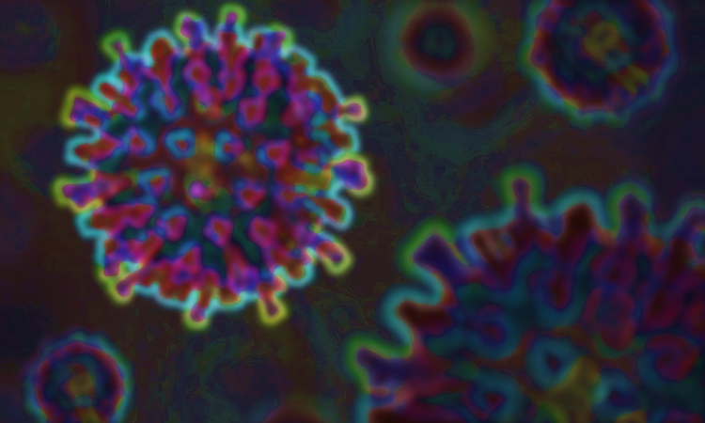
AREA OF THE PROJECT
Convolutional Neural Networks
Also known as shift invariant or space invariant artificial neural networks (SIANN).
Comprises of regularized versions of multi-layer perceptrons.
Takes advantage of the hierarchical pattern in data to assemble more complex patterns using smaller and simpler patterns.
Requires relatively little pre-processing compared to other image classification algorithms.
Tensor-shaped input ((number of images) x (image height) x (image width) x (image depth)).
Requires fixed sized images.
Abstracts image to a feature map with shape (number of images) x (feature map height) x (feature map width) x (feature map channels).

Slide 7
Commonly used for analysis of visual imagery.
Applications of CNNs:
Image and video recognition
Recommender systems
Image classification
Medical image analysis
Natural language processing
Financial time series
etc.

Slide 8
Spatial Pyramid Pooling (SPP)
Enables CNNs to work with varying image sizes.
Acts as a new layer between the convolutional layers and the fully-connected layers.
Divides the feature maps output by the last CNN into a number of spatial bins with sizes proportional to the image size.
Hence the number of bins remains fixed regardless of the image size.
Bins are captured at different levels of granularity.
Fixed number of bins help in concatenating the SPP outputs to a fixed length representation.
SPPs can enable multiscale-ability for CNNs.
Requires less processing time.
Inexpensive, fast and accurate.

Slide 9
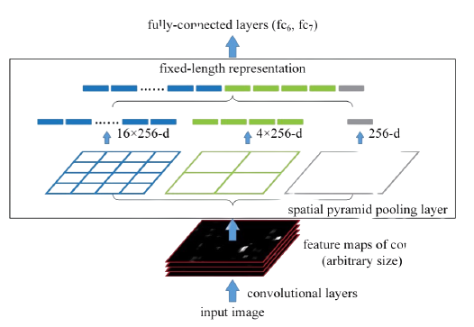
Network structure with an SPP layer. Here, 256 is filter number for conv₅ layer and it is the last layer.

Slide 10
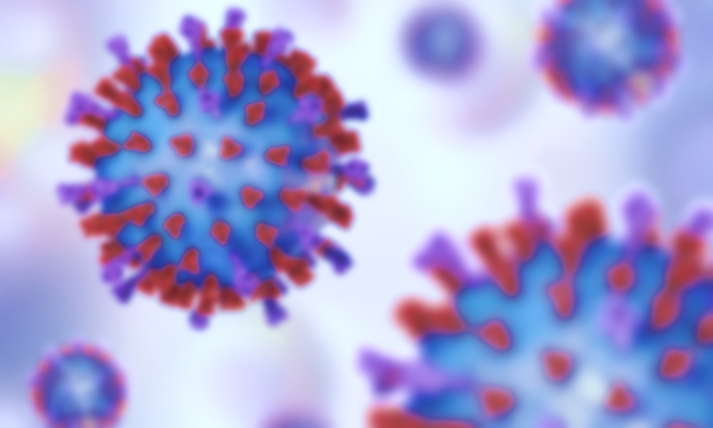
MAJOR FEATURES
Lightweight:
Can be deployed on various platforms including mobile phones, tablets, and normal computers.
Nearly 4 MB of memory requirement (model uses ~0.86 million parameters)
Multiscale-ability:
Allows model to identify different types of pneumonia disease for various severity levels.
Usage of Existent Methodologies:
Diagnosis based on chest X-ray images
14 layers of CNN with a modified SPP module.
Optimize the test time and cost.
High Accuracy.
Enables fast screening and better targeted diagnoses.

Slide 11
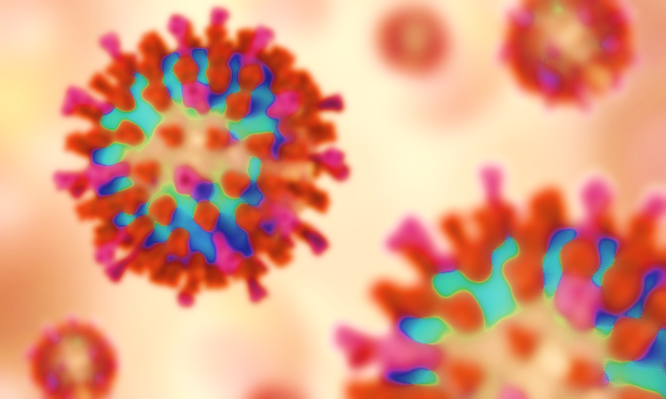
REFERENCES
Siti Raihanah Abdani, Mohd Asyraf Zulkifley, Nuraisyah Hani Zulkifley; A Lightweight Deep Learning Model for COVID-19 Detection; 2020 IEEE Symposium on Industrial Electronics & Applications (ISIEA), 2020. View at: https://ieeexplore.ieee.org/document/9188133
J. Ma, Y. Song, X. Tian, Y. Hua, R. Zhang, and J. Wu, “Survey on deep learning for pulmonary medical imaging,” Front Medicine, vol. 14, no. 4, 2019.View at: Publisher Site | Google Scholar
B. Vijay, K. Alex, and C. Roberto, “Segnet: Deep convolutional encoder-decoder architecture for image segmentation,” 2015, http://arxiv.org/abs/1511.00561.View at: Google Scholar
T. Gabruseva, D. Poplavskiy, and A. A. Kalinin, “Deep learning for automatic pneumonia detection,” in Proceedings of the IEEE/CVF Conference on Computer Vision and Pattern Recognition Workshops, vol. 1436–1443, IEEE, Seattle, WA, USA, June 2020.View at: Publisher Site | Google Scholar

Slide 12

THANK YOU

